Slide 1
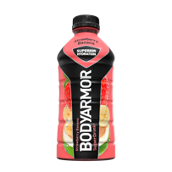
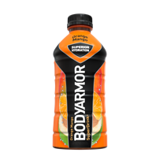
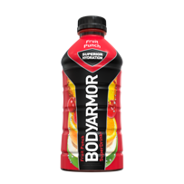
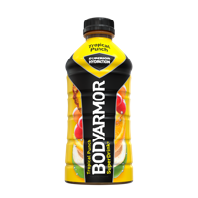
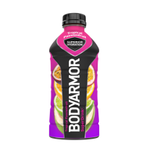
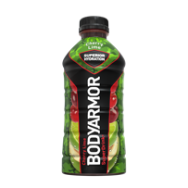
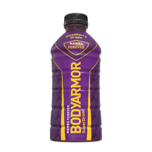
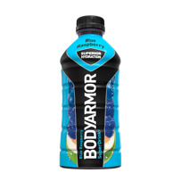
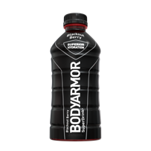
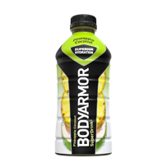
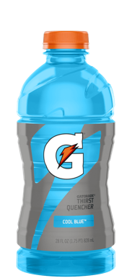
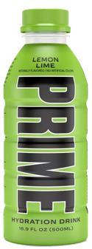
SPORTS DRINKS
Target Consumer: Young and active; athletes and health-conscious families
BODYARMOR®
Primary Flavors:
SPORTS DRINK
Strawberry Banana
Orange Mango
Fruit Punch
Tropical Punch
Tropical Passionfruit
Delivers hard-working hydration for the next generation of athletes
Reach for real hydration
Cherry Lime
Strawberry Grape (Mamba Forever)
Blue Raspberry
Blackout Berry
Pineapple Coconut
Primary SKUs: (Availability varies by flavor, package, and channel)
16oz
PET Single
28oz
PET Single
12oz
8-pack
20oz
6-pack
Natural Flavors and Sweeteners
Antioxidants
Competitive Comparison:
Coconut Water
B Vitamins
BODYARMOR
Gatorade
PRIME
Natural Flavors
Natural Flavors
Natural Flavors
#1
Potassium Packed Electrolytes
Natural Sweeteners
Natural Sweeteners
Natural Sweeteners
Source: 1) Numerator AMC. Purchase Journey - Sports Drink Category. Consumers indicating "Somewhat better or Much Better than competition" L52 W/e 10/08/23
Coconut Water
Coconut Water
Coconut Water
Sports Drink
for Product Satisfaction¹
Antioxidants: 70% | Antioxidants: 0% | Antioxidants: 100%
Potassium: 700 mg Sodium: 40mg | Potassium: 50 mg Sodium: 160mg | Potassium: 700 mg Sodium: 10mg

