Slide 1
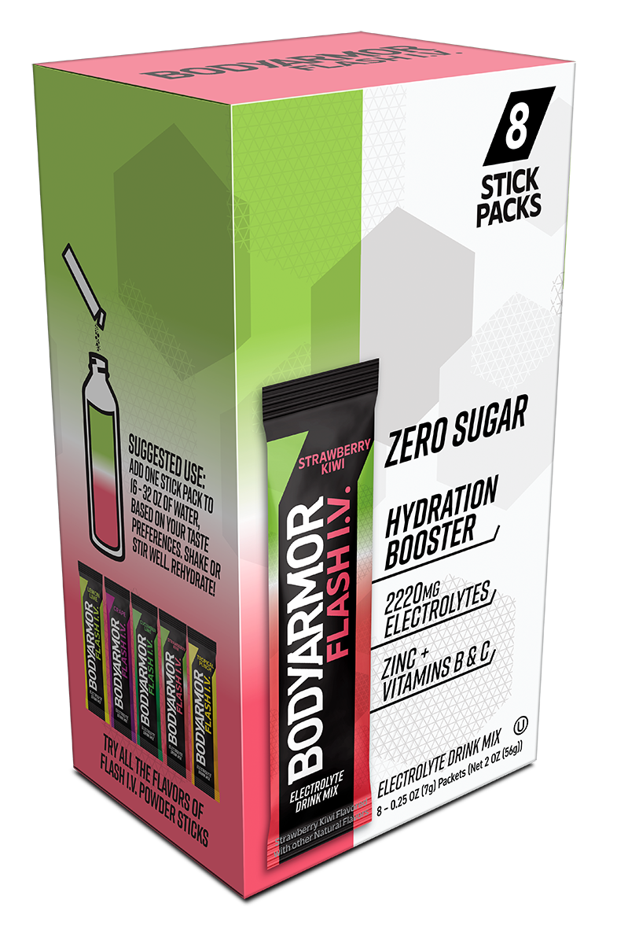
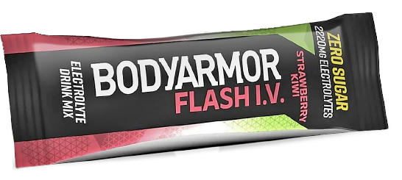
BODYARMOR
FLASH I.V. STICKS
AVAILABLE NOW!
FLAVORS Strawberry Kiwi Lemon Lime Tropical Punch
PACKAGES Singles 3pk ( SK, LL) – Available upon request 6ct ( SK, LL, TP, G, CL) 8ct (SK, LL, TP)
CHANNELS 6ct, 8ct - All sub-channels in scope 3pk – Vending, micro markets
ZERO SUGAR
10 Calories per Stick
2200+ mg Electrolytes
No Artificial Flavors, Dyes, or Sweeteners
Immune Support
Great Taste
THE HYDRATION ENHANCERS CATEGORY $ SALES HAS GROWN
+34%
IN THE LAST YEAR
Source: Nielsen. AMC. 52 w/e 03.30.24, Numerator. Data Explorer. W/E 3/24/24

Slide 2
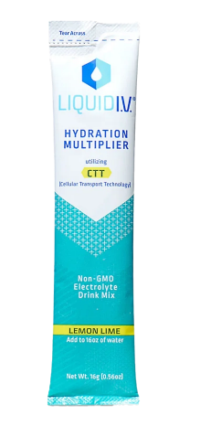
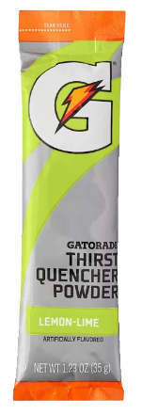
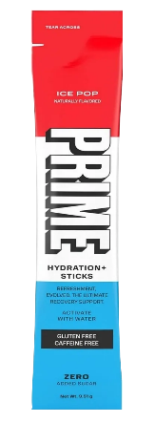
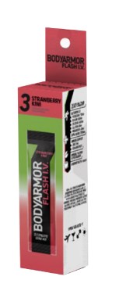
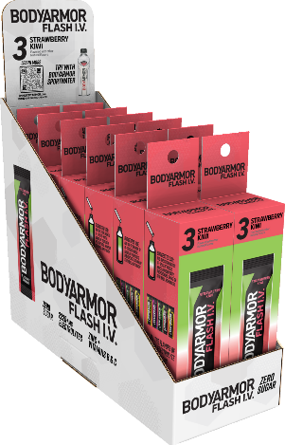
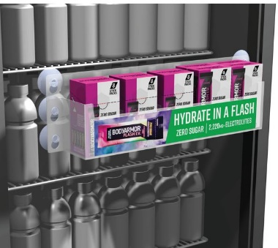
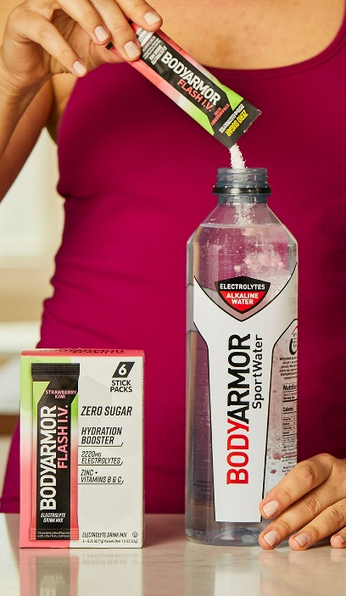
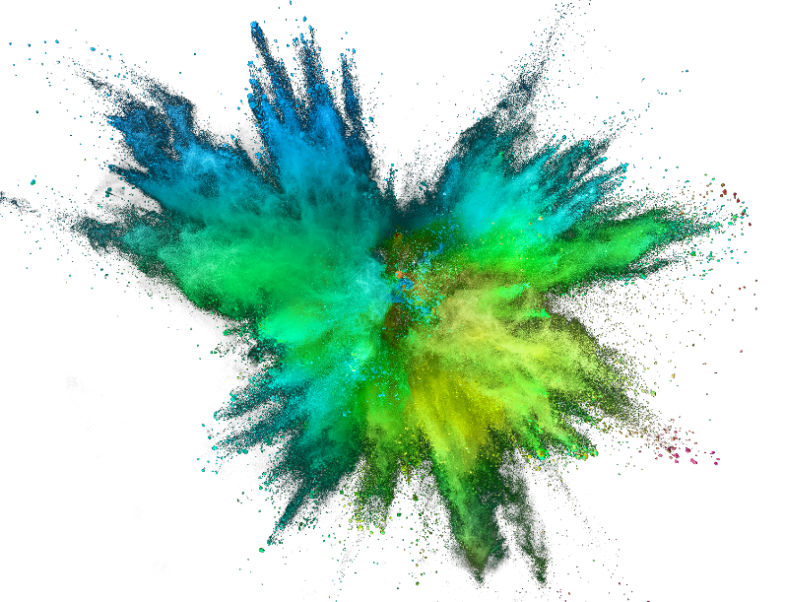
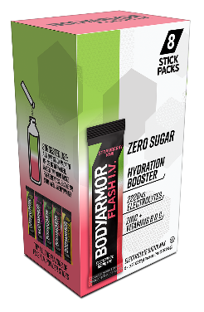
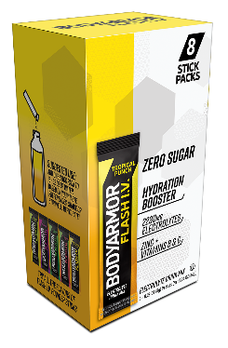
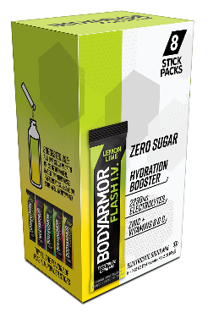
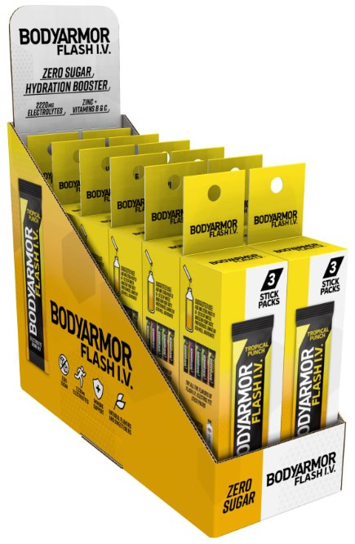
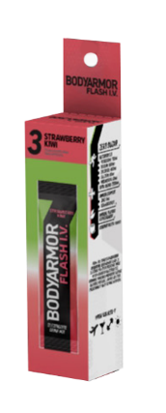
MERCHANDISING OPTIONS
TALE
OF THE
TAPE
* based on a serving size of 1 powder stick
 | FLASH I.V. | LIQUID I.V | GATORLYTE | NUUN | GATORADE | PRIME
Potassium Sodium Chloride TOTAL ELECTROLYTE BLEND | 700mg 500mg 860mg 2,220mg | 370mg 560mg — 930mg | 350mg 490mg 1,040mg 2,405mg | 150mg 300mg 40mg 515 mg | 70mg 230mg — 300mg | 700mg 40mg — 964mg
CALORIES | 10 | 50 | 45 | 10 | 130 | 25
TOTAL CARBOHYDRATES | 1g | 13g | 12g | 2g | 34g | 6g
SUGAR | 0g | 11g | 10g | 1g | 32g | 2g
ZINC |  | — | — | — | — | —
VITAMINS B & C |  |  | — |  | —
COCONUT WATER POWDER |  | — | — | — | —
The perfect pairing with BODYARMOR SportWater
WINNING FLAVORS
Strawberry Kiwi
Tropical Punch
Lemon Lime

