Slide 1
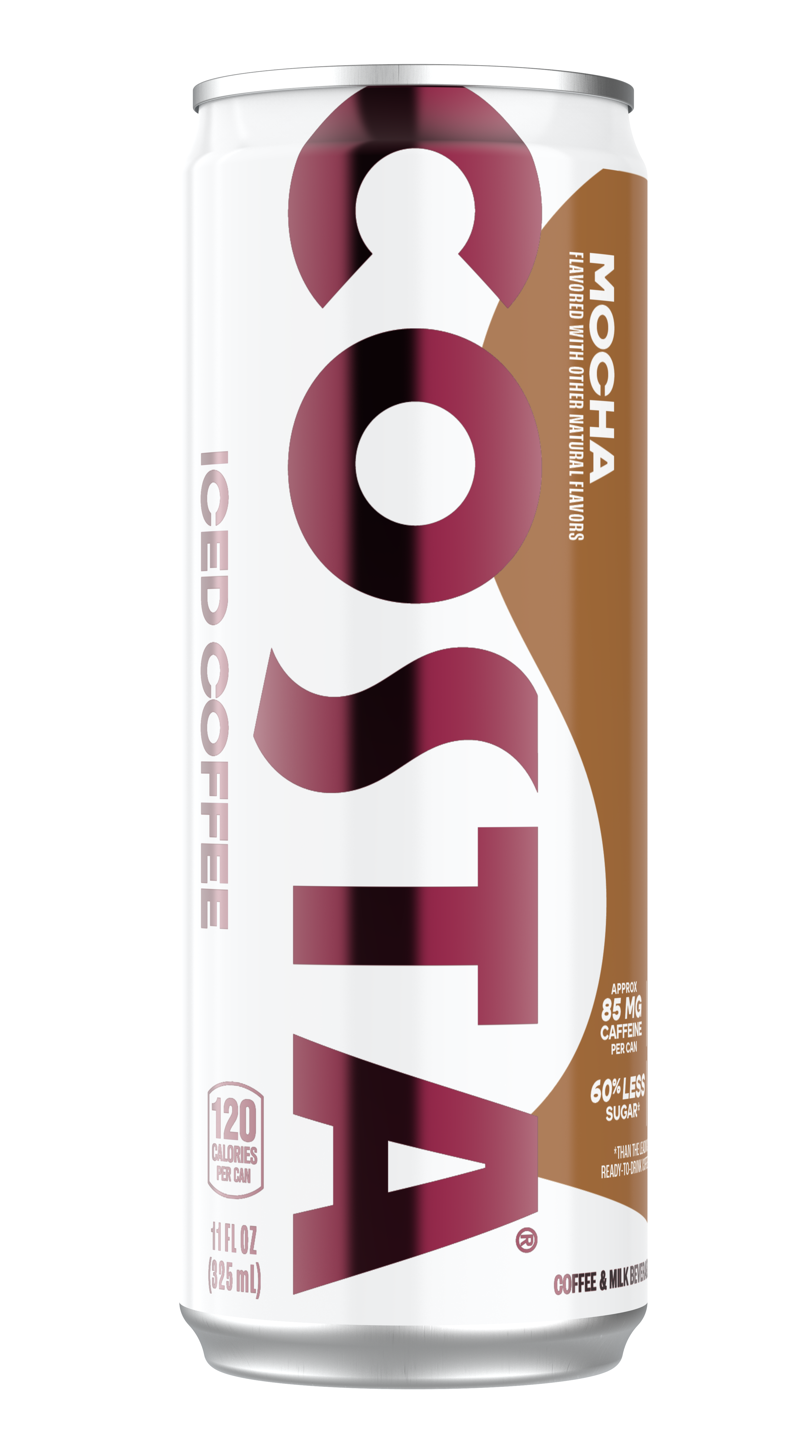
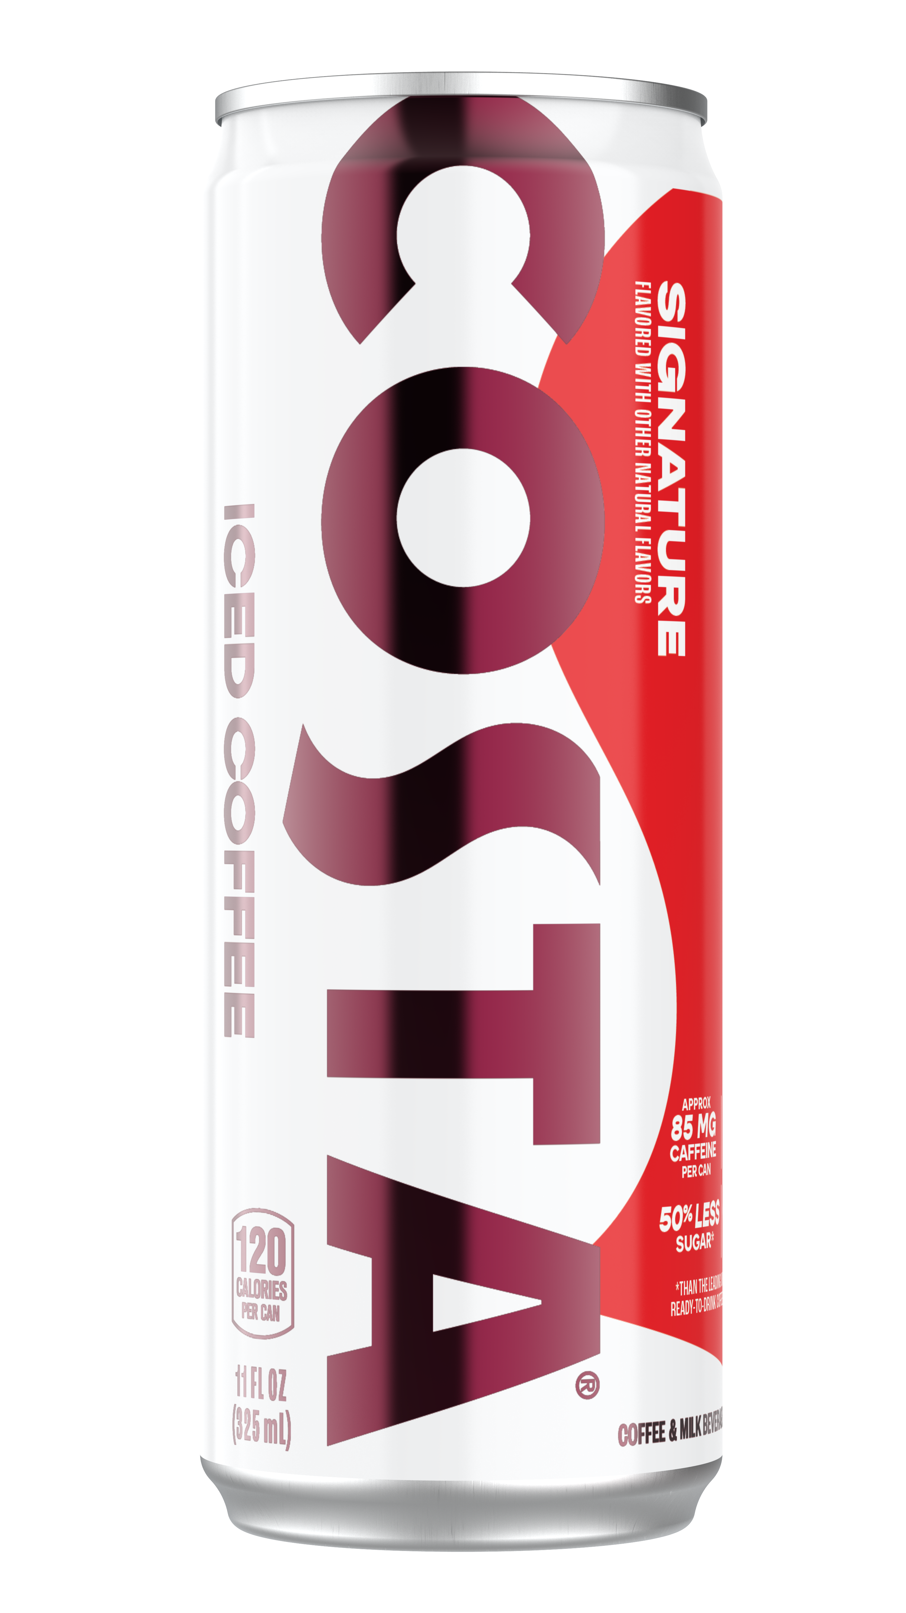
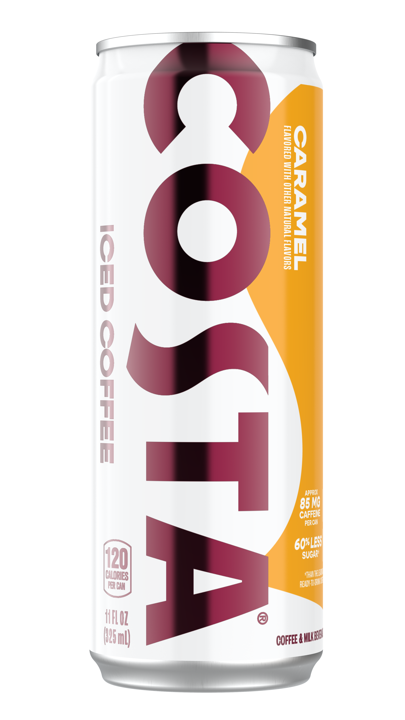
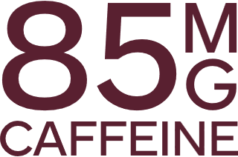
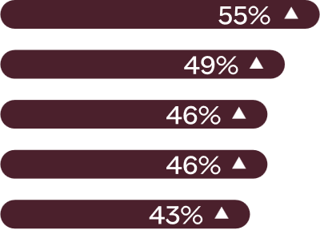
PACKAGE
SHELF LIFE
PRICE
PRIMARY CHANNEL
SECONDARY CHANNEL
CATEGORY PLACEMENT
SCOPE
TIMING
11oz can
9 months
90-day customer
freshness guarantee
Competitive against competition
LS, CR, FSOP
Drug, Value
Permanent space in the single serve coffee set
US—WRTM; DSD Pilot in Reyes
March 31, 2025
Rich coffee flavor comes through
PURCHASE DRIVERS
High in caffeine
No artificial ingredients
Creamy milk texture in perfect harmony
Short ingredients list
RICH
MOCHA
SMOOTH
SIGNATURE
CREAMY
CARAMEL
Low in sugar
Low in calories
Indicates segment is significantly higher than all others at 95% CI
SINGLE
11 OZ CAN
CONSUMER TARGET
Gen Z
Age 18-24
High SEL
Urban
8X more likely to value natural ingredients
Balanced active lifestyle
Self-determined & committed
True originals
Authentic in everything they do
6X more likely to favor low sugar than other RTD coffee consumer
45% to 60%¹ less sugars than RTD category leaders in similar flavors
REASON TO BELIEVE Costa is positioned as a reason to choose a convenient cold coffee with real milk and real cane sugar, targeting those who enjoy an active lifestyle. A story of category incrementality for higher basket rings vs other categories that serve the fuel need state.
Balanced taste. Far from boring. A convenient daily dose of vibrancy.
Real milk and real cane sugar. 85mg of caffeine­­—made a little better.
Sugar Content: 13 g of total sugar (45% to 60% less than leading ready to drink coffee products in same flavors).
Caramel: 60% Less Sugar than the Leading Caramel Ready-to-Drink Coffee Beverage* (*Costa: 13g of sugar per 11 fl oz serving. Leading Caramel RTD Coffee Beverage: Approx. 37g of sugar per 11 fl oz serving)
Mocha: 60% Less Sugar than the Leading Mocha Ready-to-Drink Coffee Beverage* (*Costa: 13g of sugar per 11 fl oz serving. Leading Mocha RTD Beverage: Approx. 37g of sugar per 11 fl oz serving)
Signature: 45% Less Sugar than the Leading Unflavored Ready-to-Drink Coffee Beverage* (*Costa: 13g of sugar per 11 fl oz serving. Leading Unflavored RTD Beverage: Approx. 26g of sugar per 11 fl oz serving)
All Current Products: 45% Less Sugar than the Leading RTD Coffee Drink* (*Costa Iced Coffees products contain 13g of sugar per 11 fl oz serving . The leading RTD full calorie drinks in comparable flavors contain approx. 26-37g of sugar per 11 fl oz serving.)
Base: Monthly RTD coffee drinkers (n=3200), Costa Consumer Target (segmented from Monthly RTD Coffee Drinkers) (n=1346)
RTD Coffee Monthly Drinkers: You’ve mentioned that the following characteristics are important to you when choosing a ready-to-drink coffee beverage. Please choose the top 3 most important items and drag them into the boxes, where 1 is the most important, 2 is second-most important, and 3 is 3rd most important. Costa Consumer Target: How important are the following characteristics when choosing a ready-to-drink coffee beverage?

